Slide 1
WELCOME To Mahideb Jubo Somaj Kallayan Somity (MJSKS) Ulipur, Kurigram.

Slide 2
A PRESENTATION ON Livestock Monitoring System (LMS) for Artificial Insemination in Dairy & Beef Cattle (AIDBC) Project [Innovation Scale up Fund Project]

Slide 3
→The livestock farming is one of the most important livelihood options for rural families in Bangladesh. → Unfortunately the sector faces a number of challenges such as scarcity of veterinarians, affordability of in-house veterinary services by poor farmers, record keeping of livestock husbandry procedures and expert advice during emergency situation. → So the Intelligent Livestock Health Management System is created to address and become primary solution to the challenges with the use of smart phone based application - Livestock Monitoring System (LMS). Brief about LMS: • The Livestock Monitoring System (LMS) is a real time monitoring and management tool which is new & innovative smart phone technology approach to provide livestock service in rural areas of Bangladesh.
Brief Overview

Slide 4
• It analysis and assess the collected data for providing necessary suggestions to the beneficiaries for better management practices, treatment and other related services of their animal. • The mPower Social Enterprises Ltd. provided technical support to carryout of Android mobile device technology with a pre-loaded software. • The system was deployed through Android mobile handset with built-in questionnaire for collecting information on cattle by visiting door to door household and sends it to server. • The project veterinarians identify problems by reviewing the information on a web-based interface which was sent by the project field officers through their smart phone. • Then expert veterinarian provide suggestions on the cases.
Brief Overview

Slide 5
Objectives of LMS
To assist management and technical staffs about real time status of livestock
To take preventive measures well in advance
To set the propriety for providing emergency treatment or advice
To monitor huge number of animal in short time and eases the data record keeping
To collect instant information which aids in immediate response in contrast to conventional system.
To facilitate better management of livestock project and mitigates the risks of cattle.

Slide 6
Working Area
Country : Bangladesh
District : 01 → Kurigram
Upazila : 03 → Ulipur, Rajarhat & Kurigram Sadar
Union : 09
Villages : 35
Target BHHs : 2000
# Cattle : 3895
Project Duration : 2.5 Years (July 2013 to December 2015)

Slide 7
How the system works
Local Livestock Worker/ Field Officer registered the farmer and cattle use their mobile phone application
After successful registration system gives an unique ID for the farmer and their livestock
The LLW/ FO makes casual visit every month to all registered farmers to collect & sent follow up data focusing on cattle husbandry issues
In cases of cattle sickness, he/she goes to the household immediately & captures relevant cattle health information on the mobile application and sent it to project’s expert veterinarians

Slide 8
How the system works- Cont..
The expert veterinarian having access to LMS desh board & given prescription or suggestions
The LLW/ FO receives the advice in his mobile phone instantly and act accordingly
This results in one veterinarian being able to provide services to many livestock farmers
A poor farmer being able to afford expert services at low cost
Records are digitized and can be accessed in updated from any where

Slide 9
Impact/Benefits of LMS
Quick response to husbandry practices
Ensure proper treatment in right time
Aware about seasonal disease outbreak
Acceptance and confidence developed for livestock rearing
Morbidity & mortality rate decreased thus increase financial benefit
Receive different services at household level without moving their animal which saves time and transport cost
Familiar with the modern technology
Practicing modern livestock rearing techniques in contrast to conventional system.

Slide 10
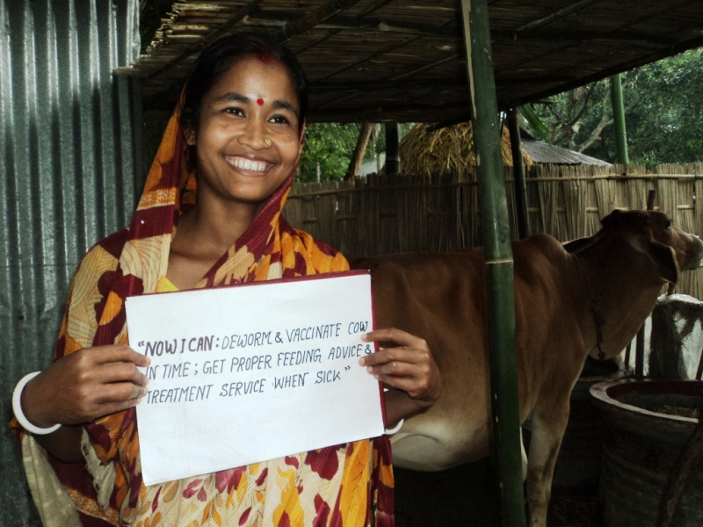
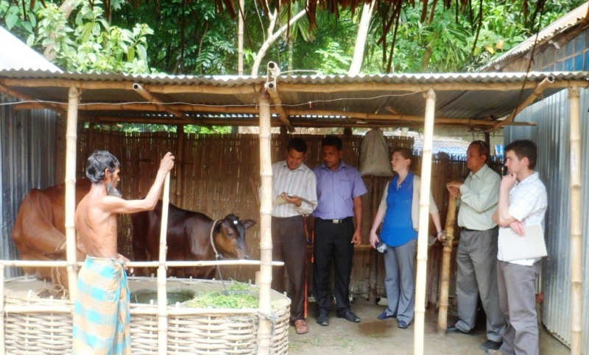
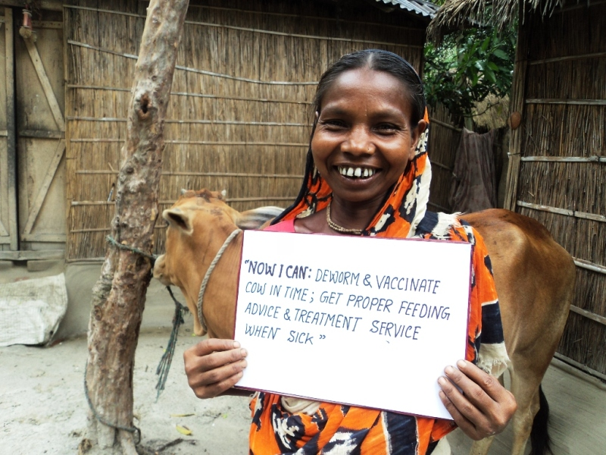
Photo Gallery

Slide 11
Challenges associated with LMS
Challenges:
Sometimes in few areas poor mobile network interrupt regular data collection
Drop out of trained staff

Slide 12
Thanks
to
all MJSKS-EEP/Shiree-AIDBC Project Ulipur, Kurigram, Bangladesh

